Slide 1

Item-Specific and Relational Encoding are Effective at Reducing the Illusion of Competence
Nicholas P. Maxwell, M.S.

Slide 2
Introduction
Metacognitive judgments are commonly used to investigate the learning process
How confident are you that you’re providing the correct answer? (retrospective)
How likely are you to remember this item pair? (prospective)

Slide 3
Judgments of Learning (JOLs)
Participants study cue-target pairs (e.g., mouse-cheese)
Estimate their ability to recall the target item if shown only the cue (e.g., mouse - ?)
Typically use 0-100 rating scale but can also use Likert scale or binary ratings
Scale JOLs are most common!
Easy to compare with percent correct recall!
Compare predicted recall with actual recall

Slide 4
What influences JOL accuracy?
Word Associations can influence memory
Words become associated through use in language or similarity in meaning
Compound words like Mailbox
Sets of objects like Table and Chair
Opposites like On and Off

Slide 5
Associations
Memory is affected by more than just the presence of associations
Association Strength and Direction also impact memory!
Strength is measured by Forward Strength (FSG)
Probability that cue elicits target as response
Free association norms (e.g., Small World of Words; De Deyne et al, 2019)
Generated through Free Association Tasks

Slide 6
Associative Direction
Forward associates (Dog-House) are more likely to be remembered because the target is a common response to the cue
Forward Associates: Dog – House
Backward Associates: House – Dog
For backward pairs, the target IS NOT a common response to the cue, even though the words are thematically related!

Slide 7
Associative Direction
Backward pairs like house – dog are deceptive!
People rate their ability to remember them highly but struggle to recall them at test
JOLs are high but recall is low!
Illusion of Competence – occurs when JOLs overestimate recall as a function of pair direction (Koriat & Bjork, 2005)

Slide 8
Illusion of Competence (Koriat & Bjork, 2005 )

Slide 9
Reducing the Illusion of Competence
Maxwell & Huff extended to include symmetrical pairs (e.g., King-Queen)
Replicated Illusion of Competence across several conditions
JOLs made w/ study (made while viewing pair)
JOLs made immediately after study (pair not visible)
JOLs made after a delay
How can the illusion of competence be reduced?
Encoding tasks that increase recall to match JOLs?

Slide 10


Item-Specific/Relational Encoding
Encoding tasks differ in the likelihood that they encourage processing of unique or related features of study pairs
Item-Specific – Cats have fur but turtles have shells, cats are mammals but turtles are reptiles, etc.
Relational – Both are living creatures, both kept as pets, etc.

Slide 11
Item-Specific/Relational Encoding
Item-Specific/Relational tasks are deep encoding tasks (Craik & Lockhart, 1972)
Deep encoding tasks boost memory because they force participants to engage in greater processing at study
Recall is best when both item-specific and relational strategies are used together!

Slide 12
The Present Study
Goals:
Replicate the illusion of competence for backward, symmetrical, and unrelated pairs for standard JOL instructions (Control group)
Combine Item-Specific/Relational processing w/ JOLs to reduce the illusion of competence by boosting recall to match JOLs
Hypotheses:
The illusion of competence will be reduced when participants use these strategies compared to the control group
Item-specific will produce greatest benefit to related pairs
Relational will produce greatest benefit to unrelated pairs

Slide 13
Participants and Materials
88 participants (Sona)
Item-specific (n = 29)
Relational (n = 31)
Control Group (n = 28)
Materials: 180 word pairs
Forward (credit-card)
Backward (card-credit)
Symmetrical (king-queen)
Unrelated (artery-bronze)
20 non-tested buffer pairs (primacy/recency effects)

Slide 14
Procedure
Study/JOL
Filler Task
Recall
Notes:
Note that this procedure was used in the remaining Experiments

Slide 15
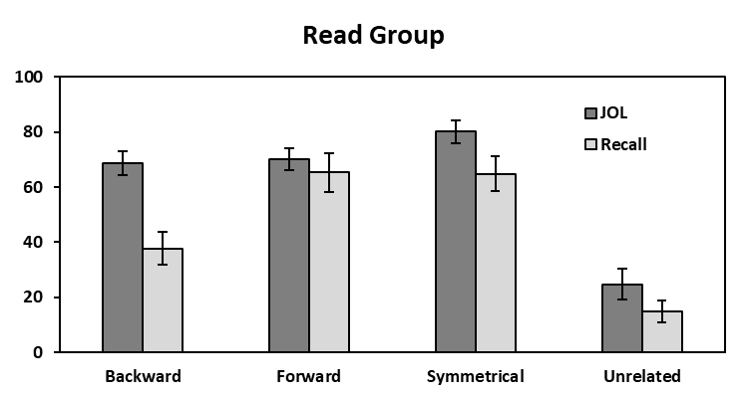
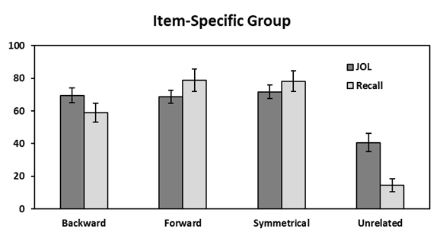
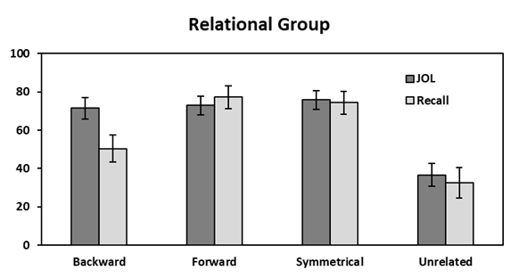
Results: Illusion of Competence
Control Group
Bars = 95% CI

Slide 16
Summary
Item-Specific/Relational strategies are effective at reducing the illusion of competence
Item-specific most effective for backward (i.e., related) associates
relational most effective for unrelated pairs
Metamemory is improved when the study strategy compliments the study materials!

Slide 17
Future Directions
“Think-Aloud” procedure
Ensure participants are engaging in the correct encoding strategy
Warn participants about deceptive word pairs
Could potentially reduce Illusion of Competence by reducing JOLs to match recall

Slide 18
Thank you!
Questions?

